Slide 1
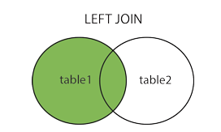
SQL LEFT JOIN
The LEFT JOIN keyword returns all records from the left table (table1), and the matched records from the right table (table2). The result is NULL from the right side, if there is no match.
In some databases LEFT JOIN is called LEFT OUTER JOIN
LEFT JOIN Syntax
SELECT column_name(s) FROM table1 LEFT JOIN table2 ON table1.column_name = table2.column_name;

Slide 2
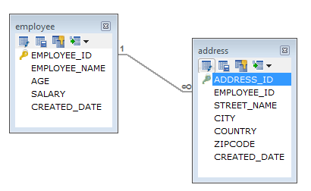
SQL LEFT JOIN
In a one-to-many relationship, one record in a table can be associated with one or more records in another table.

Slide 3
SQL LEFT JOIN
Employee
EMPLOYEE_ID | EMPLOYEE_NAME | AGE | SALARY | CREATED_DATE
1 | Peter | 32 | 7000 | 2019-09-03
2 | Dave | 34 | 8000 | 2019-09-04
3 | John | 45 | 10000 | 2019-09-24
Address
ADDRESS_ID | EMPLOYEE_ID | STREET_NAME | CITY | COUNTRY | ZIPCODE | CREATED_DATE
1 | 1 | 18,Dark Street | Chennai | India | 680009 | 2019-09-10
2 | 1 | 90,West Street | Bangalore | India | 655556 | 2019-09-18
3 | 2 | 898,East Street | Bangalore | India | 565565 | 2019-09-14
4 | 2 | 676,North Street | Chennai | India | 767676 | 2019-09-18
5 | 2 | 434,Good Street | Kerala | India | 656565 | 2019-09-16

Slide 4
SQL LEFT JOIN
LEFT JOIN Example
SELECT employee.EMPLOYEE_ID,employee.EMPLOYEE_NAME,address.CITY
FROM employee
LEFT JOIN address ON employee.EMPLOYEE_ID=address.EMPLOYEE_ID;

